Slide 1
Final Project Rubric
Your slides should include:
Title, Authors
(15%) Motivation: Introduce your question and why the question is interesting. Explain what has been done before in this space. Describe your overall plan to approach your question. Provide a summary of your results. (Wesley)
(15%) Data: Describe in detail the data you are using, including the source(s) of the data, preprocessing applied to the data, and relevant statistics. (Eun-Hae) (summarize features for other sections)
(15%) Modeling: Describe in detail the models (baseline + improvement over baseline) that you use in your approach. (Ben)
(30%) Experiments: Provide insight into the effect of different hyperperameter choices. Please include tables, figures, graphs to illustrate your experiments. (Nancy)
(10%) Conclusions: Summarize the key results, what has been learned, and avenues for future work. (Wesley)
(15%) Code submission: Provide link to your team's GitHub repo. The code should be well commented and organized. (Ben)
Contributions: Specify the contributions of each author (e.g., data processing, algorithm implementation, slides, etc.). Note that the final project grade is individual, based on each member's contribution and team size.

Slide 2
DS207: Credit Score Classification
Benjamin He, Eun-Hae Ko, Jianyi (Nancy) Teng, Wesley Thomas

Slide 3
TABLE OF CONTENTS
01
04
02
05
03
06
Motivation
Experiments
Data
Conclusions
Modeling
Contributions

Slide 4

Motivation
Credit scores are a crucial part of assessing individuals credit worthiness
Credit can impact lives in myriad ways: renting, applying for mortgages, buying a car, etc
Opportunity for implementing data driven decisions
Large dataset with variety of features

Slide 5
Motivation
Recent exploration of credit scores with logistic regression, decision trees, and ensemble methods
Limited work with neural networks

Slide 6
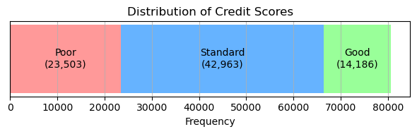
Data
Source: Kaggle https://www.kaggle.com/datasets/parisrohan/credit-score-classification
Data: 100,000 observations, 28 variables
Data after cleaning: Training 43,531, Validation/Test 14,511
Y: Credit Score (Poor: 0, Standard: 1, Good: 2)
Notes:
We used the dataset on credit scores available from Kaggle.
Only the training set included our target variable credit score so we did not use the test set.
The data set had 100,000 observations with 28 features, including credit score.
After cleaning the dataset, we were left with 72,553 observations.
The remaining data was split into 60% training, 20% validation, and 20% test set.
The target variable credit score has 3 categories: Poor, Standard, and Good with Standard being the majority class.

Slide 7
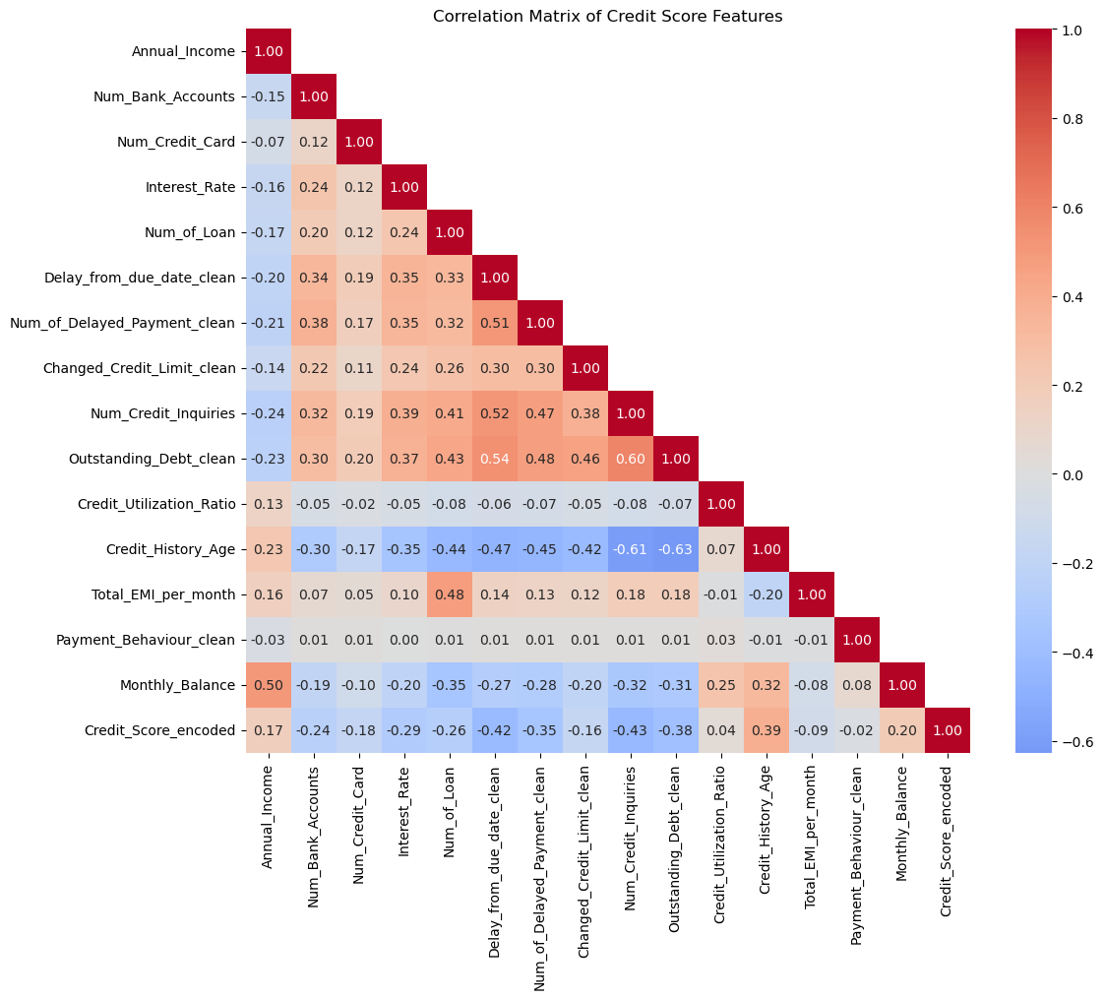
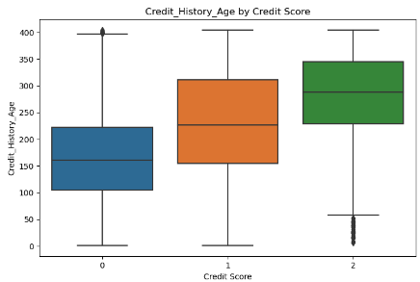
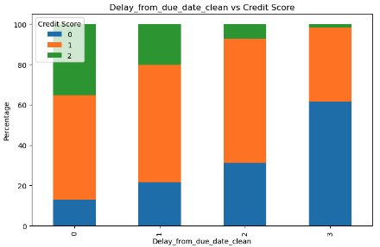
Exploratory Data Analysis
Checked feature and credit score relationship
Calculated mutual information between features and credit score for feature selection
Final model utilizes 12 features out of 27
All features are normalized to the same scale
Notes:
For exploratory data analysis, we visually checked the relationship between features and credit scores.
Correlation matrix was also helpful in identifying features that helped explain an individual's credit score.
After calculating mutual information between features and credit score, we were able to select 12 salient features out of 27 possible variables.
Since every feature were on a different scale, we normalized all features to fall between 0 and 1.

Slide 8
Main Features
Feature | Description | Impact on credit score
Outstanding_Debt | higher outstanding debt increases credit utilization ratio | Negative
Annual_Income | higher income can signal better repayment capacity | Positive
Total_EMI_per_month | higher EMI may indicate financial strain | Negative
Interest_Rate | higher interest can lead to longer repayments | Negative
Num_Credit_Inquiries | frequent inquiries can indicate financial strain | Negative
Delay_from_due_date | missed/delayed payments hurt credit score | Negative
Num_Credit_Card | depending on balance and repayment behavior, may go both ways | Neutral
Num_Bank_Accounts | does not affect credit score unless there are overdrafts/loans | Neutral
Credit_History_Age | older accounts have higher credit score | Positive
Changed_Credit_Limit | increase in credit limit increases credit utilization ratio | Positive
Num_of_Loan | may indicate over-leveraging, depending on repayment behavior | Neutral
Num_of_Delayed_Payment | frequent delayed payments hurt credit score | Negative
Notes:
These are the 12 features we included in the final model.
We analyzed each variable for it’s possible impact on credit score.
For example, a longer credit history will have a positive impact on the person’s credit score.
And since it is highly correlated with someone’s age, there is no reason to include both in the model.

Slide 9
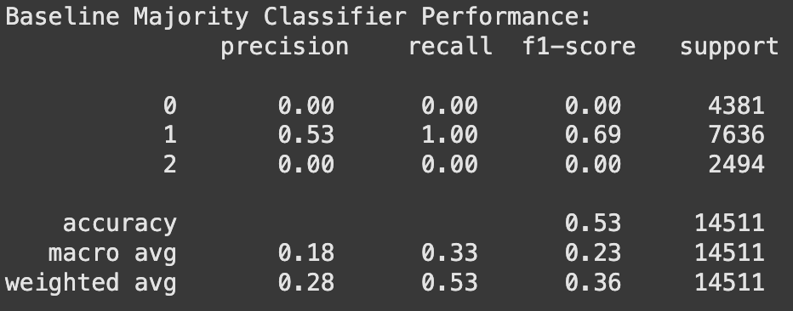
Modeling: Baseline - Majority Classifier
3-Class Prediction Task:
[“poor”, “standard”, “good”] integer-encoded to [0, 1, 2]
Majority class was 1, so baseline model just predicts 1 for every feature input.
Notes:
To establish a baseline for our project, we used a majority class classifier.
As mentioned earlier, our dataset consists of three label classes for categorizing credit scores: 'poor', 'standard', and 'good'.
For computational convenience, these labels were integer-encoded into 0, 1, and 2, respectively.
The majority class in the training set, representing 'standard' and encoded as 1, accounted for approximately 53% of the total labels.
As expected, the baseline model predicted class 1 for all test samples.
When evaluated on the test dataset, the baseline model achieved a weighted F1 score of 0.36.
This low score reflects the inherent limitations of a majority class classifier and provides a reference point for assessing the improvements achieved with more sophisticated models.

Slide 10
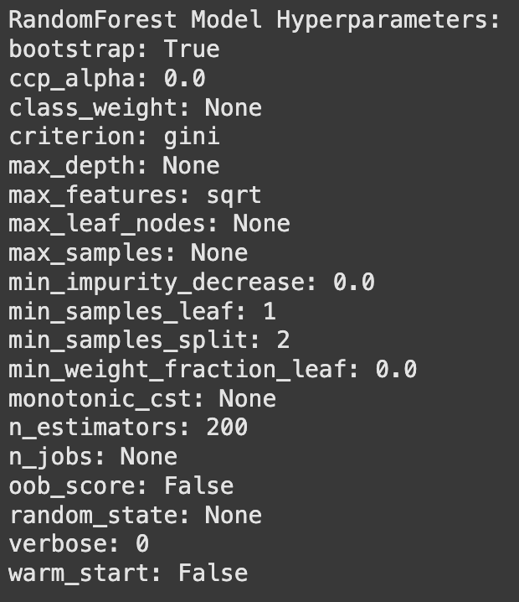
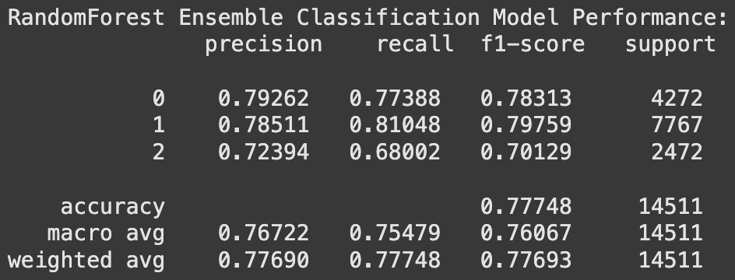
Modeling: RandomForest Ensemble Classifier
Baseline weighted f1 score: 0.36
RandomForest Model’s weighted f1 score: 0.78
Improvement over baseline: 0.42 or 117%
Notes:
For our first main model, we implemented a Random Forest ensemble classifier using the sklearn library.
This model builds upon our baseline majority class classifier that again got an f1 score of 0.36.
After training and evaluating the Random Forest model, we achieved a weighted F1 score of 0.78, representing a 117% improvement over the baseline.
To optimize performance, we focused on tuning several key hyperparameters:
max_depth, which controls the depth and complexity of each decision tree.
Max_features, which is the maximum number of features considered for splitting at each node, helping balance accuracy and randomness.
N_estimators, or the number of estimators or trees in the ensemble, which influences stability and generalization.
Bootstrap, deciding whether to bootstrap the data for sampling or use the entire dataset for training each tree.
And class_weight, which decides whether to balance classes using inverse weights.
These hyperparameters allowed us to fine-tune the model, striking a balance between overfitting and generalization.
The results clearly demonstrate the value of Random Forests as a robust and flexible modeling approach for our dataset.

Slide 11
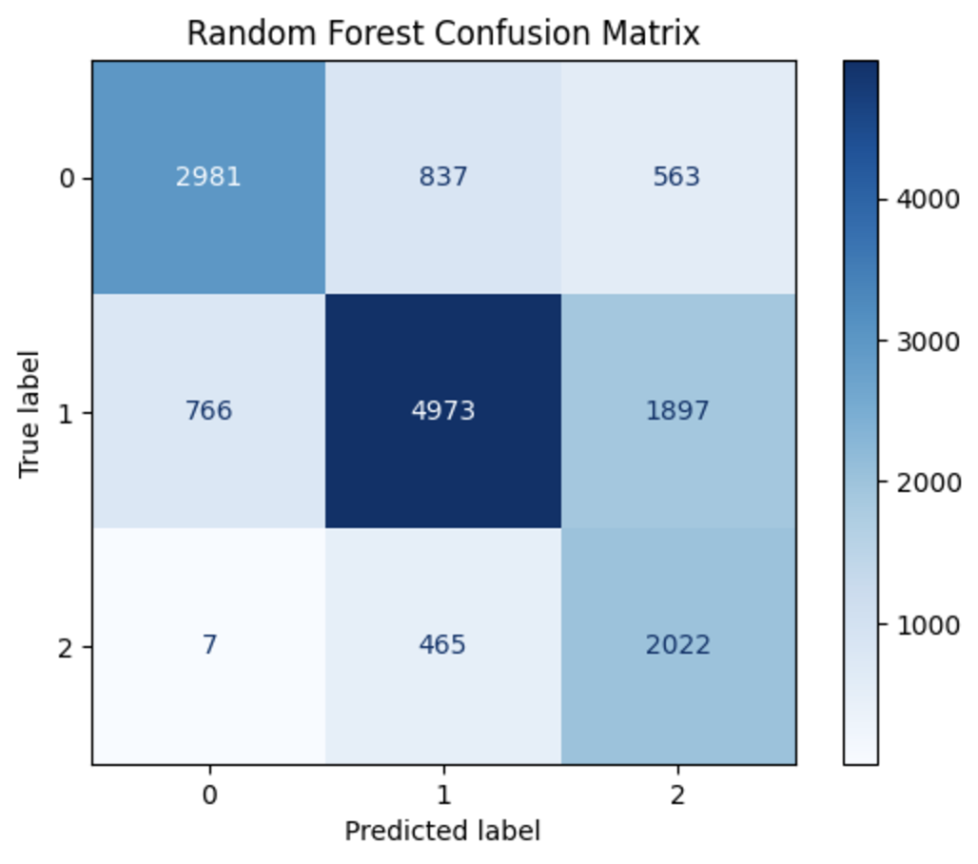
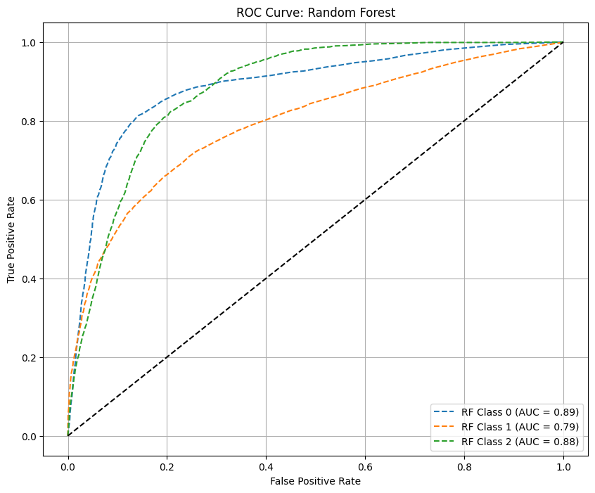
Modeling: RandomForest Ensemble Classifier
Notes:
To help evaluate our Random Forest model, we also analyzed the confusion matrix and ROC AUC scores.
From the confusion matrix, we observe that:
Class 1 has the highest number of correct predictions but also the highest misclassification rate, with 34% of samples misclassified.
Class 0 seemed to have better accuracy than Class 1 with 32% misclassifications and Class 2 achieved the lowest rate of misclassifications at 19%.
Looking at the ROC AUC scores:
Class 0 and Class 2 performed more strongly than Class 1, with AUCs of 0.89 and 0.88, respectively.
Class 1 showed the weakest performance with an AUC of 0.79.
These results highlight the model's overall strong performance but suggest a need for optimization especially in handling Class 1.

Slide 12
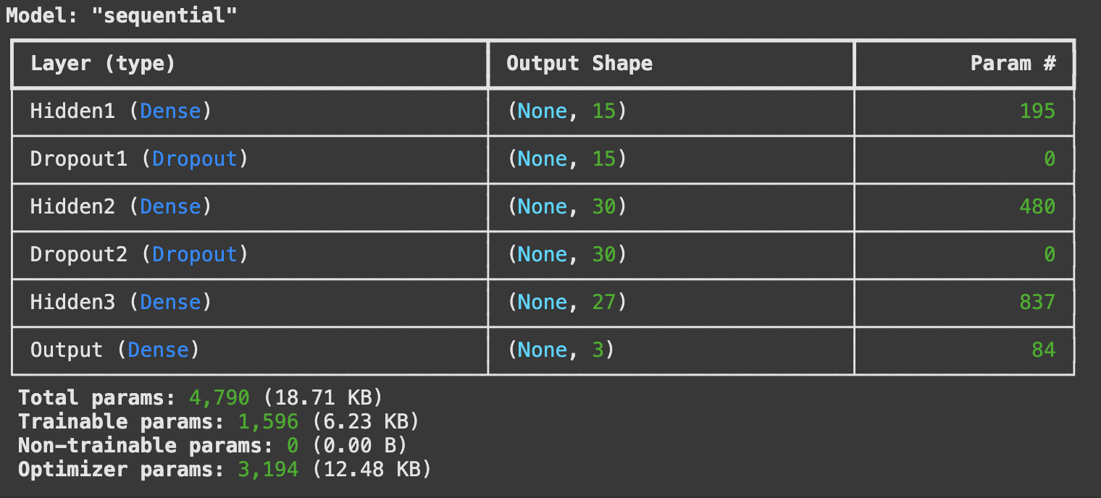
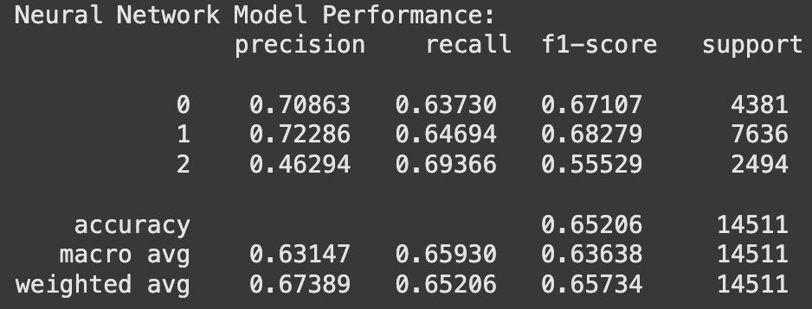
Modeling: Neural Network Classifier
Best model was tuned using keras_tuner
Baseline weighted f1 score: 0.36
Neural Network Model’s weighted f1 score: 0.66
Improvement over baseline: 0.30 or 83%
15 units, tanh
rate 0.4
30 units, relu
rate 0.1
27 units, tanh
Optimizer: Adam,
Loss Function: SparseCategoricalCrossEntropy
Notes:
Our second main model was a neural network for multiclass classification, designed and trained using Keras.
The best-performing model was tuned using the Keras Tuner library, enabling us to systematically explore hyperparameter combinations for optimal performance.
Using keras_tuner, we focused on varying the number of hidden layers, the number of units and activation function for each densely connected hidden layer, the dropout rate for hidden dropout layers to prevent overfitting, and the choice of optimizer.
The tuned hyperparameters of our best neural network model can be seen in the lower left image.
Compared with our baseline, which again had a weighted F1 score of 0.36, the neural network model showed significant performance improvement, achieving a weighted F1 score of 0.66.
This represents an f1 score increase of 0.30, or approximately 83% over the baseline.
This result highlights the neural network’s ability to capture more complex patterns in the data compared to simpler models, though it still underperformed relative to the Random Forest model.

Slide 13
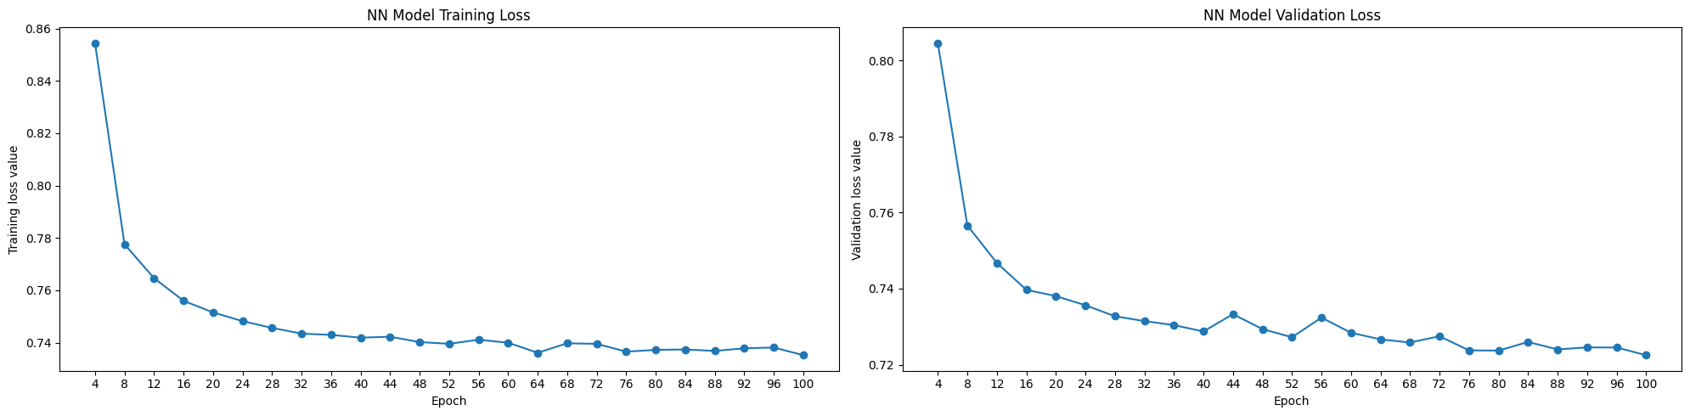
Modeling: Neural Network Classifier
Notes:
Here are the training and validation loss values over 100 epochs for the tuned neural network.
They both show continuously decreasing loss values in general until they level out.
This primarily indicates that our model is not overfitting to the training data and that increasing the number of epochs would likely not lead to significant performance improvements.

Slide 14
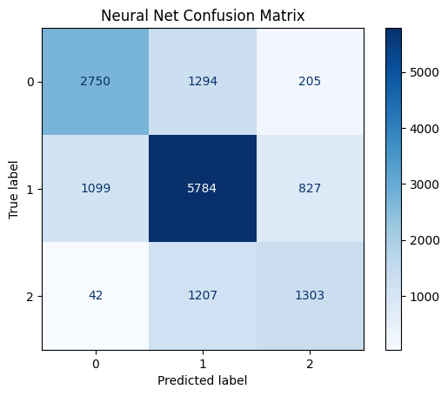
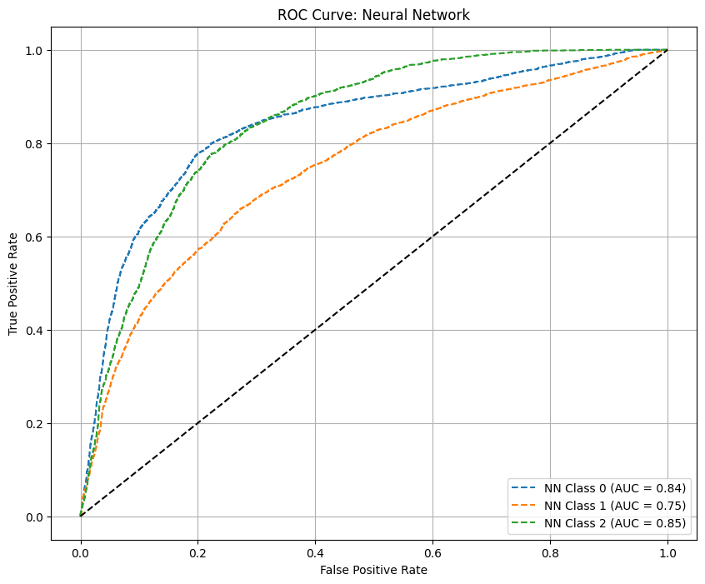
Modeling: Neural Network Classifier
Notes:
We also analyzed the confusion matrix and ROC AUC scores for our neural network model.
From the confusion matrix, we observe that Class 1 has the most number of correct predictions and the overall lowest rate of misclassifications at 25%.
Class 0 and Class 2 had higher misclassification rates at about 35% and 49% of instances respectively.
In terms of the ROC AUC scores however, the model demonstrates stronger performance for Class 0 and Class 2 with AUCs of 0.84 and 0.85 respectively.
The model performed weakest for Class 1 with AUC 0.75, suggesting potential issues due to class imbalance in the data.
Overall, the neural network shows promising results, particularly for Class 0 and Class 2, but efforts to improve Class 1 predictions in particular would enhance the model's overall performance.
Between our two main models, the randomforest was our best performing one.

Slide 15
Experiments- Feature Selection
Feature Selection Method:
Using weights in single layer model
Using Mutual information Score [Final choice with better performance ]
Feature Name | Mutual Info score
Annual_Income | [0.4126888]
Num_Bank_Accounts | [0.10072859]
Num_Credit_Card | [0.10900728]
Interest_Rate | [0.17431903]
Num_of_Loan | [0.07584597]
Delay_from_due_date | [0.10105481]
Num_of_Delayed_Payment | [0.07254994]
Changed_Credit_Limit | [0.10357179]
Feature Name | Mutual Info score
Num_Credit_Inquiries | [0.11448791]
Outstanding_Debt | [0.45593802]
Credit_History_Age | [0.10154341]
Total_EMI_per_month | [0.3486516]
Credit_Utilization_Ratio | [0.00503285]
Payment_Behaviour | [0.00573746]
Monthly_Balance | [0.02957289]
Notes:
We began the experiment with feature selection. Using the exploratory data analysis (EDA) results presented in the Data section as a foundation, we conducted two feature selection analyses.
The first method involved using feature weights value in a neural network model. We trained a single-layer model on the sample dataset and calculated the contribution of each feature to the final classification result based on its weights. Features with the highest weights were selected. However, this method did not yield satisfactory results. The single-layer model performed poorly, achieving only an F1 score of 0.45, which negatively impacted the reliability of the feature selection process.
Given these limitations, we moved on to our second method: calculating the mutual information score between each feature and the target variable. The table in the slides presents the mutual information scores for all features. Based on these results, our team decided to proceed with the top 12 features as input. Credit Utilization Ratio, Payment Behavior, and Monthly Balance were excluded from model training due to their low information scores, indicating weak dependency with the target variable.

Slide 16
Experiments - hyperparameter tuning
— On Neural Network Classifier
Learning Rate | Num of Hidden Layers | Hidden Layer Size | Activation Function | Num of Epochs | Weighted F1 Score
0.001 | 0 | n/a | Relu | 50 | 0.56344
0.001 | 0 | n/a | Relu | 100 | 0.58593
0.001 | 0 | n/a | Relu | 150 | 0.59797
0.01 | 0 | n/a | Relu | 50 | 0.60126
0.01 | 0 | n/a | Relu | 100 | 0.60472
0.01 | 0 | n/a | Relu | 150 | 0.61107
0.01 | 1 | 3 | Relu | 150 | 0.62008
0.01 | 1 | 6 | Relu | 150 | 0.61454
0.01 | 2 | 6 | Relu | 150 | 0.63898
0.01 | 3 | 6 | Relu | 150 | 0.37136
0.01 | 1 | 6 | Tanh | 150 | 0.65217
0.01 | 2 | 6 | Tanh | 150 | 0.64768
0.01 | 3 | 6 | Tanh | 150 | 0.37318
0.01 | 1 | 10 | Relu | 150 | 0.65364
0.01 | 1 | 15 | Relu | 150 | 0.65241
0.01 | 1 | 20 | Relu | 150 | 0.65700
0.01 | 1 | 20 | Relu | 200 | 0.65534
0.01 | 1 | 20 | Tanh | 200 | 0.65136
Notes:
After feature selection, we proceeded with hyperparameter tuning to enhance model performance, as mentioned in the Model section. We experimented with two different models: a Neural Network Classifier and a Random Forest Classifier.
For the Neural Network Classifier, we began by manually tuning hyperparameters such as the learning rate, activation function, and number of epochs. Additionally, we tested the impact of adding hidden layers and adjusting their size to improve model accuracy. Once we developed a better understanding of the effect of each hyperparameter, we used Keras Tuner to identify the best-performing hyperparameter. The optimal model featured a learning rate of 0.01, one hidden layer with a size of 20, the ReLU activation function, and 150 epochs. This hyperparameter achieved an F1 score of 0.657.

Slide 17
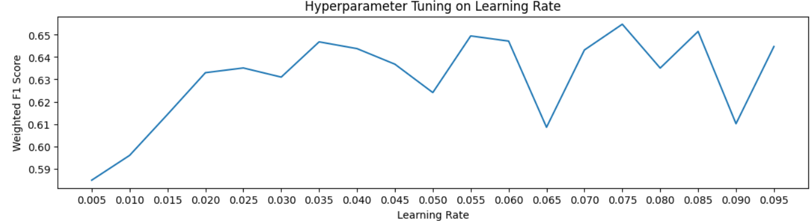
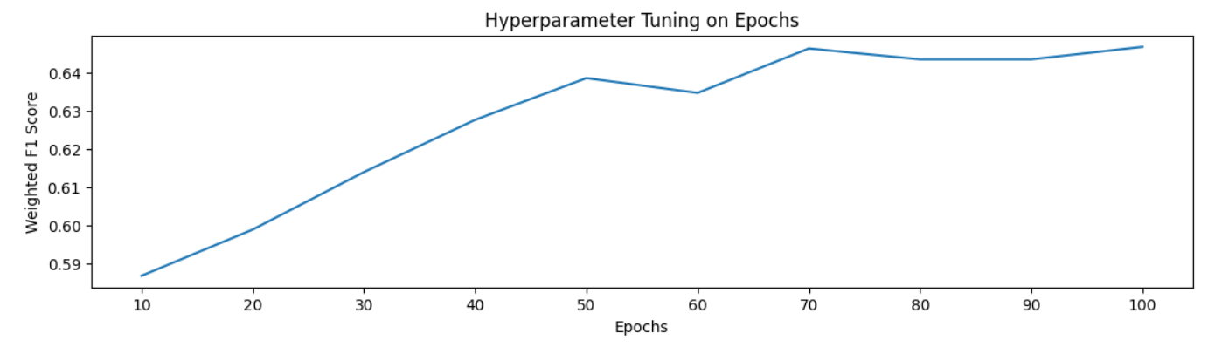
Experiments - hyperparameter tuning
— On Neural Network Classifier
Notes:
During the tuning process, we analyzed the relationship between the learning rate, number of epochs, and the F1 score (a measure of model performance) to guide our hyperparameter tuning.
From the top visualization, we tuned the learning rate within a range of 0.005 to 0.1, using increments of 0.005. The F1 score initially showed an increasing trend, suggesting that a learning rate of 0.005 or lower might result in steps that are too small for effective model training. Starting at 0.03, the F1 score began to fluctuate, indicating that the learning rate might be too large to effectively converge on the optimal solution.
From the bottom visualization, we tuned the number of epochs within a range of 10 to 100, using increments of 10. The F1 score exhibited an overall increasing trend before plateauing, suggesting that the number of epochs should exceed 100. Based on these insights, we ultimately selected 150 epochs as the optimal hyperparameter for our final model.

Slide 18
Experiments - hyperparameter tuning
— On Random Forest Ensemble Classifier
Max Tree Depth | Max Features | Num Estimators | Bootstrap Data? | Class Weight | Weighted F1 Score
None | sqrt | 50 | True | None | 0.77125
None | sqrt | 75 | True | None | 0.77409
None | sqrt | 100 | True | None | 0.77404
None | sqrt | 150 | True | None | 0.77340
None | sqrt | 200 | True | None | 0.78155
None | sqrt | 250 | True | None | 0.77232
None | 0.2 | 200 | True | None | 0.77461
None | 0.5 | 100 | True | None | 0.77233
None | 0.5 | 200 | True | None | 0.77400
None | 0.8 | 200 | True | None | 0.77291
None | sqrt | 200 | False | None | 0.77362
None | 0.2 | 200 | False | None | 0.77332
None | sqrt | 200 | True | Balanced | 0.77142
None | sqrt | 200 | False | Balanced | 0.77091
30 | sqrt | 200 | False | None | 0.77373
40 | sqrt | 200 | False | None | 0.77396
50 | sqrt | 200 | False | None | 0.77334
60 | sqrt | 200 | False | None | 0.77317
Notes:
For our second main model—the Random Forest Ensemble Classifier—we focused on tuning several hyperparameters, including the maximum tree depth (to control model complexity), the maximum number of features considered for splitting at each node, the number of estimators, whether to balance class weights, and whether to bootstrap the data.
From our observations, we found that enabling bootstrapping and increasing the number of estimators significantly improved model performance. Ultimately, we achieved a weighted F1 score of 0.782 using 200 estimators and the square root method for selecting features at each node. This represents a 117% improvement over the baseline.

Slide 19
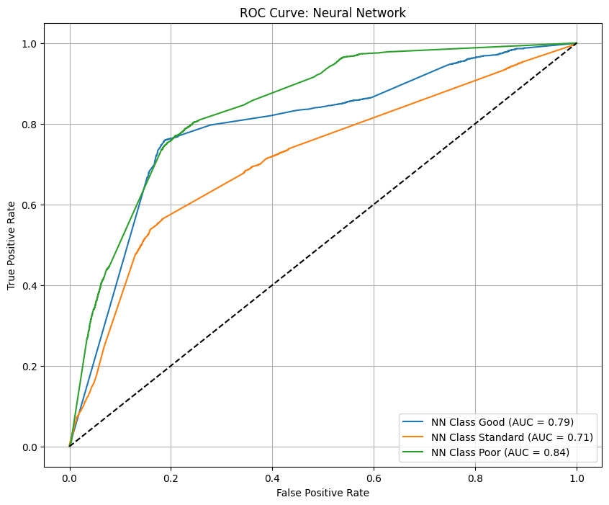
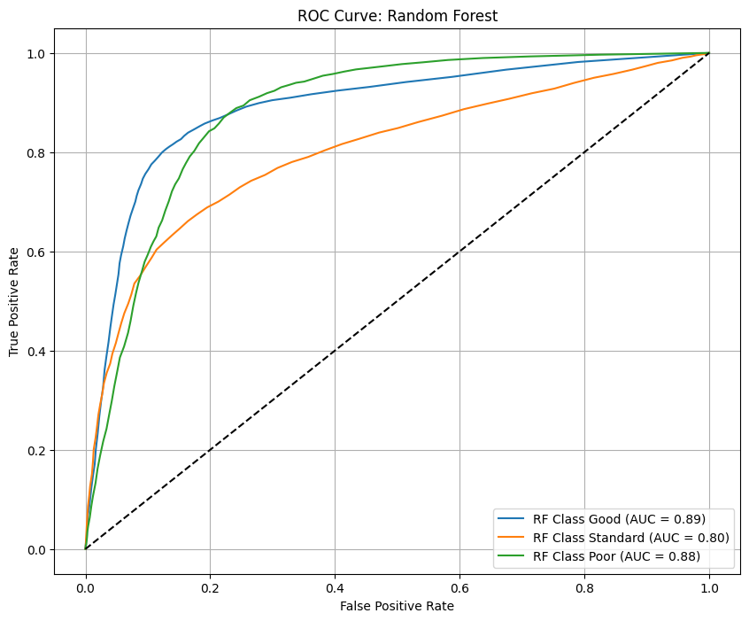
Conclusions
Random Forest outperforms Neural Net
Weighted f1
Neural Net: .66
Random Forest: .78

Slide 20
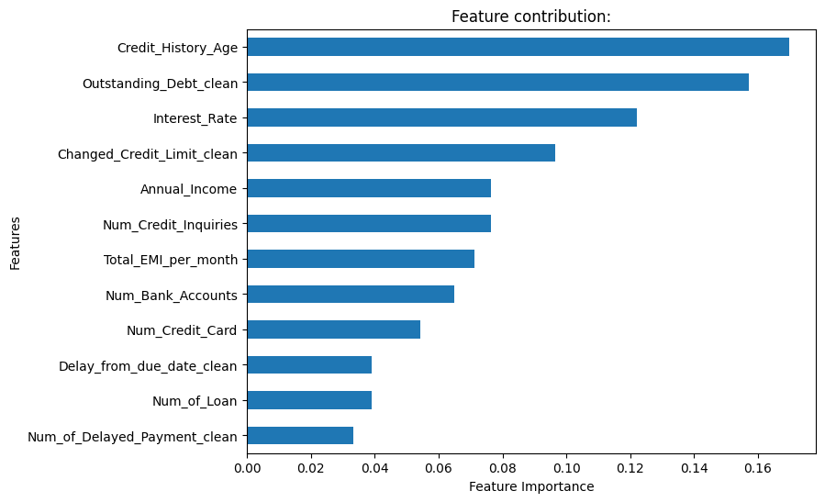
Conclusions
Credit history contributes most
Delayed Payments contribute least

Slide 21

Conclusions
With accuracy of 74%, significant room for improvement remains
Further hyperparameter tuning
Larger dataset
More balanced classes

Slide 22

THANK YOU!
Github Repo: https://github.com/UC-Berkeley-I-School/mids_fall24_ds207_final/tree/main

Slide 23
Contributions
Ben: Drove weekly progress meetings. Organized code submission and contributed to code for dataset cleaning & preprocessing, EDA, model training and tuning (both main models), and model evaluations. Contributed to slides (primarily Modeling sections).
Eun-Hae: Data cleaning/preprocessing, EDA, model exploration/tuning/exploration (logistic mode), slides (data section)
Jianyi (Nancy): Contributed to dataset cleaning/preprocessing, model training and tuning (Neural Network Classifier) and model evaluations, contributed to slides (experiment sections)
Wesley: Data preprocessing/cleanup, model exploration/tuning & evaluation, confusion matrices, ROC plots

